Slide 1
Bio-Info Terminal
07/23/2018
Matthew I Cintron

Slide 2
“Smart Lab” Idea
Purpose: automate routine tasks in the bio-analytical laboratory
Information look-up: ability to assist with intelligent search for compound properties, chemical equipment, etc.
Simple unit conversion : e.g. moles to grams, etc.
Assistance in solution preparation
Assistance in mobile phase preparation
Assistance in organization of experimental observation – connection to ELN
Other usages

Slide 3
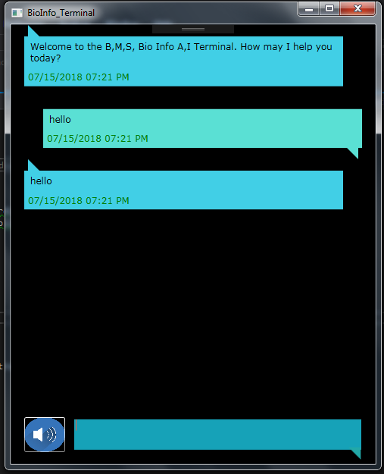
Bio Info – Terminal
This tool represents the second stage of a Alexa skill I built a demo for a little while showing a virtual lab assistant
The tool was linked to an a basic in house AI
I have since given it a new interface and taken all interaction with Alexa out
It has the ability to get basic chemical info and calculations for things such as molarity
Current focus is on improving usefulness and vocal interaction

Slide 4

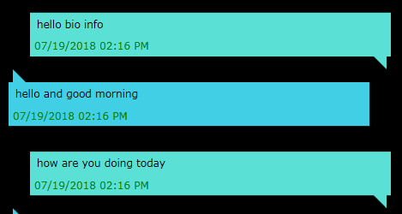
Basic Conversation
The first target for the platform was to simply engage with basic conversation like a chat bot with the user
This helped us set a baseline for our model as well as begin the challenging process of delving into speech processing and natural language processing that we hope to add to our program as development continues
More info on NLP-
https://www.sas.com/en_us/insights/analytics/what-is-natural-language-processing-nlp.html

Slide 5
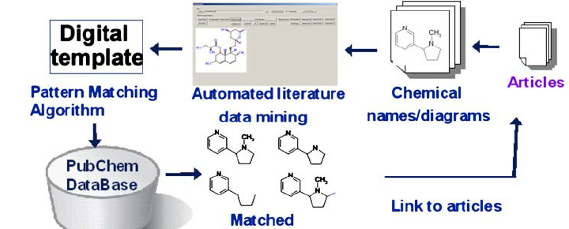
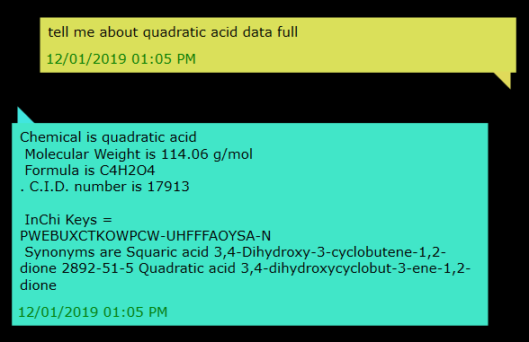
Information look-up: chemical equipment, etc.
Next I sought to develop more direct research tools such as those that would gather information from our local Data bases and ones around the world
Currently we implement this by connecting with REST service’s from databases like Pub Chem and HMDB
With these we can access mountains of chemical data quickly and easily
More info on Pug-REST-
http://pubchemdocs.ncbi.nlm.nih.gov/pug-rest

Slide 6


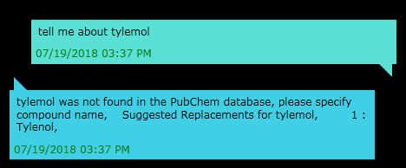
Checking User Query's
Next we worked on developing an system that could not only take query's world wide and seek answers both here and online but also asses those query's and evaluate them for errors
To do this we utilized dictionary libraries from NHunspell for to check Spelling and other accuracies within our users requests when we fail to find anything to give them suggestions
More info on NHunspell -
https://www.nuget.org/packages/NHunspell/

Slide 7
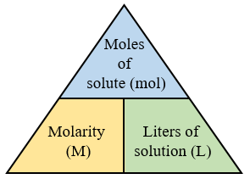
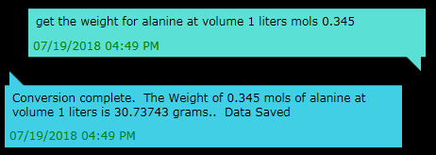
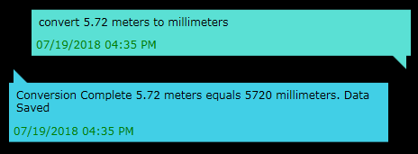
Simple unit conversion : moles to grams, etc
Next I worked on one of the most essential components a scientific assistant could possess and that is unit conversion
Our software as of now can do many basic conversions such as meters to millimeters but it can also now get grams from mols and volume and volume when only knowing mols and weight in grams
We will be expanding this in the future to a massive library of conversion options

Slide 8
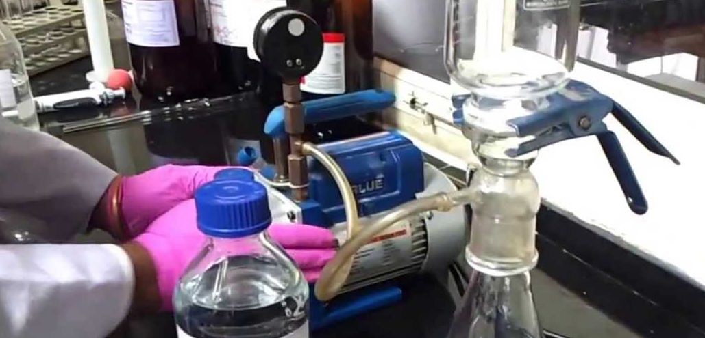
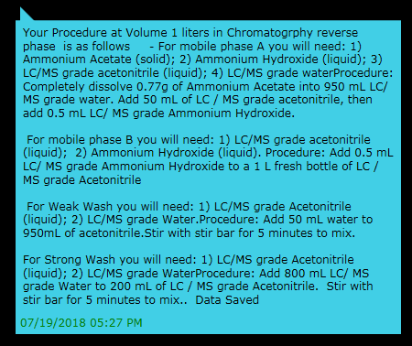
Assistance in mobile phase preparation
One of the final fields I have been working on for the utility of Bio info has been in lab based prep assistance specifically for mobile phase
By giving the program simple information like the volume of your solution and the form of chromatography you are working in Bio Info will give you a fully mapped step by step procedure to preform your lab prep

Slide 9
How to Use Bio Info Skills
1 - Unit conversion -
state convert followed by the size –first and then second unit of measurement-
2 -Chemical info-
just say tell me about chemical than the target compound or state-
tell me about – or – get data on – followed by the compound name-
3 – Calculate Molarity-
to begin write “calculate molarity” – “get molarity” or anything along those lines including “the molarity” you can ask the question any way you like just be sure to put “chemical” before the compound “volume” before the volume in liters and “weight” before the weight in grams

Slide 10
How to Use Bio Info Skills 2
4 – Calculate weight-
to begin write “calculate weight” – “get weight” or anything along those lines including “the weight” you can ask the question any way you like just be sure to put “chemical” before the compound “volume” before the volume in liters and “mols” before the concentration in mols
5– Calculate volume-
to begin write “calculate volume” – “get volume” or anything along those lines including “the volume” you can ask the question any way you like just be sure to put “chemical” before the compound “weight” before the weight in grams and “mols” before the concentration in mols

Slide 11
How to Use Bio Info Skills 3
6– Calculate Mobile Phase-
to begin write “calculate Mobile Phase” – you can ask the question any way you like just be sure to put “volume” before the volume in liters and chromatography before the chromatography type – you can say Hilic or Reverse Phase – or 1 for Hilic and 2 for reverse phase

